Slide 1
BRAIN BUZZER BLITZ QUIZ APPLICATION
PRESENTED TO
Dr. K. Sathiyamurthy
PRESENTED BY
Shakthi S Shameidha MS
Laxman S
30-05-2023

Slide 2







Problem Statement
Creating interest among students to test their knowledge by participating in quiz events
Gives a alternative way of conducting quiz events Participating in quiz events helps students to gain knowledge

Slide 3




Objectives
To design and develop a Brain Buzzer Blitz Quiz Application
To enable students to participate in quiz with their choice of domain
To enable users to act as hosts and create their own quizzes with timings specified

Slide 4
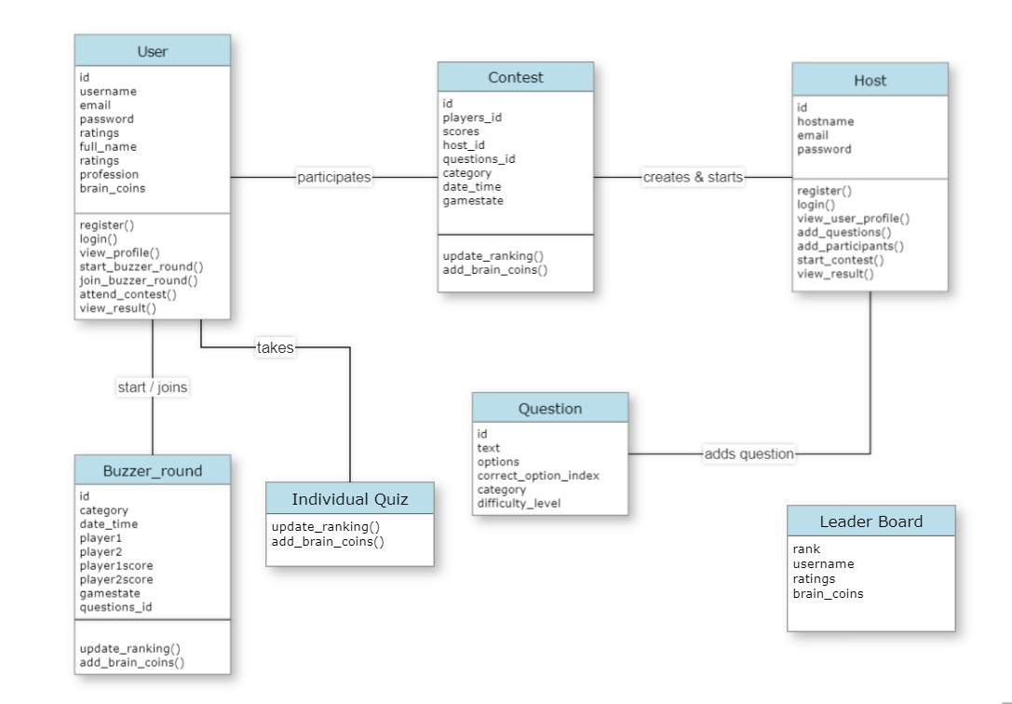
Class Diagram

Slide 5
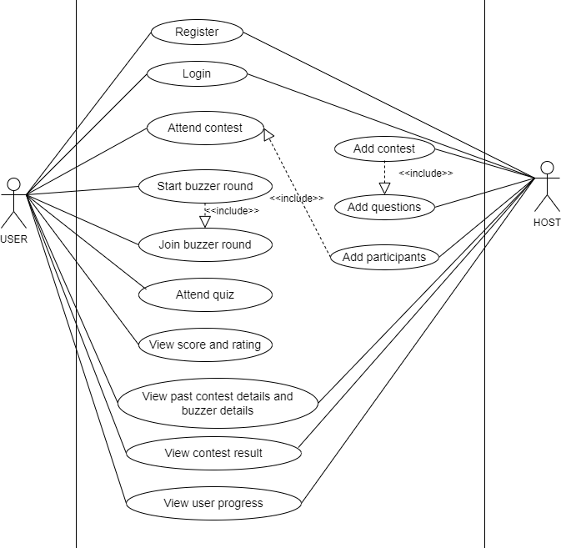
Use Case Diagram

Slide 6
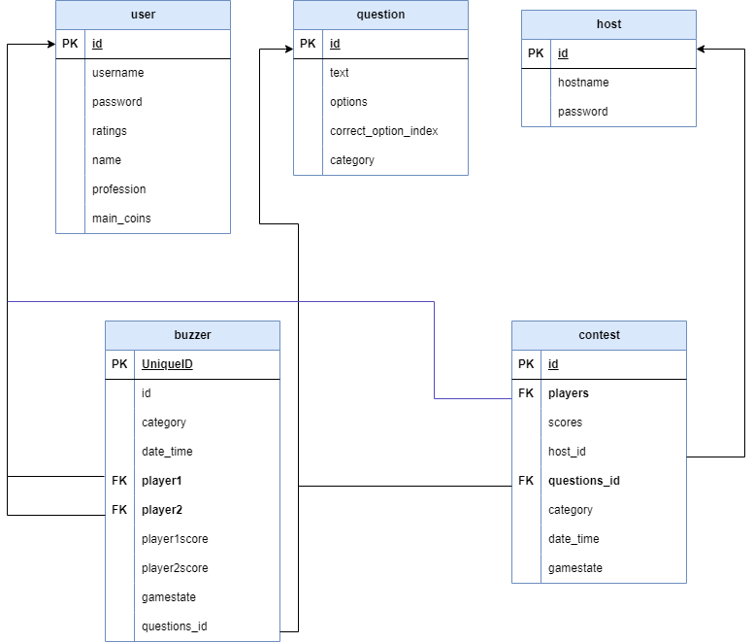
ER Diagram

Slide 7
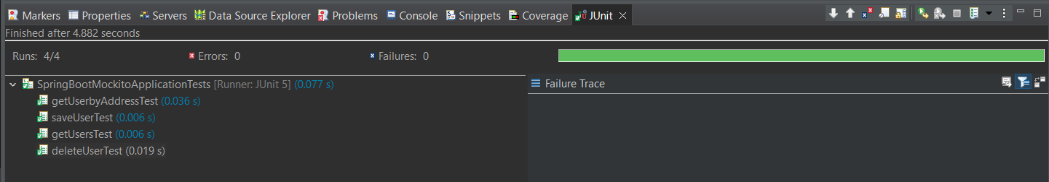
Code Testing

Slide 8
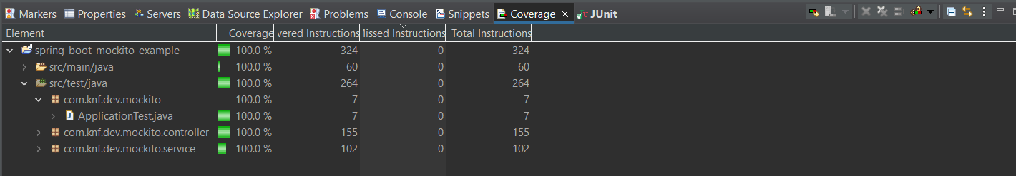
Code coverage

Slide 9
Future enhancements
A host can create questions according to their needs.
T
Can be accessed by the students with the host’s permission.
Can have ranking within their organization also.

Slide 10
Conclusion
In conclusion, by leveraging React and Spring Boot, we can build a robust and interactive quiz application. The combination of these technologies provides a seamless integration between the frontend and backend, enabling the development of engaging and feature-rich quiz experiences for users.

Slide 11

THANK YOU

